Slide 1
Change Management
SE423: Software Project Management

Slide 2
Outline
Change Control
Software Maintenance

Slide 3
Change Control

Slide 4
Software Change
Software change is inevitable
New requirements emerge when the software is under development or being used
The business environment changes
Errors must be repaired, Risks mitigated
New equipment must be accommodated
The performance or reliability may have to be improved
A key problem for organizations is implementing and managing change to their current projects and legacy systems

Slide 5
Integrated Change Control
Integrated Change Control is a project management integration knowledge area process concerned with project change requests
The Perform Integrated Change Control process is carried out from project inception through completion
All changes must be carefully controlled to maintain the integrity and consistency of the project plan
Change control encompasses review, evaluation, approval/rejection, and managing and coordinating approved changes

Slide 6
Integrated change control
Recognizes that projects will often require changes to the established project plan
All changes must be carefully controlled to maintain the integrity and consistency of the project plan
Integrated change control encompasses all aspects of change to the project:
Reviewing and approving requested changes
Managing the changes when they actually occur
Controlling elements of the project management plan (scope, cost, budget, schedule, and quality) in response to changes
Controlling changes to requirements, design, code and documentation.

Slide 7
Change or Configuration Control
Configuration Management Plan
Change & Version control
Items:
Code (source for product)
Documents: requirements, design, test plans, user guides
Plans and data bases (MS project, etc.)
Scripts for testing
Software development plan and other process documents

Slide 8
Integrated Change Control
In some projects, the Integrated Change Control process includes a change control board (CCB)
The CCB is a formally chartered group responsible for reviewing, evaluating, approving, delaying, or rejecting changes to the project, and for recording and communicating such decisions
Note that changes have a potentially greater impact in CPM scheduling:
Changes on the critical path have greatest impact while those off the critical path have less
Changes in CCM scheduling require adjustments to buffers
The same responses to change are needed, but the impact to the schedule may be less severe than in CPM

Slide 9
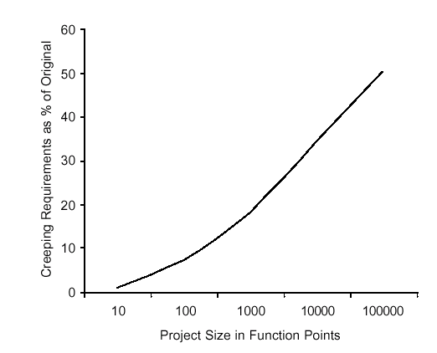
Change Control
Average project has 25% requirements change
Overly detailed specs. or prolonged requirements phase are not the answer
Sources of change
Change control is a process
Change Control Board (CCB)
Structure, process, triage

Slide 10
Control the Change – I
Need for change is recognized
Change request is submitted as a “request for change” (RFC) or engineering change order (ECO)
Developer or PM team evaluates: impact and desirability
Change report is generated
Change control authority (CCB) makes a decision to either:
Deny request.
Change request is denied
User is informed
Proceed
If change is approved:
Request is queued for action. ECO (Engineering Change Order) is generated.
Individuals assigned to configuration objects.
Objects checked out and change made.
Change audited.
Baseline established.
If it is a Software Configuration Item (SCI)
Perform SQA and testing activities
Check-in the changed objects

Slide 11
Control the Change – II
For Software Configuration Items (SCI)
Promote SCI for inclusion in next release
Rebuild appropriate version
Include all changes in release
Review/audit the change
Perform Verification and Validation [testing activities]
Distribute new version

Slide 12
Control the Change – III
Use a change management system (COTS) and a change tracking system.
Ideal if they are integrated: aka Comprehensive Software Change Management
SCM (Source code management)
Perforce – multi-platform client/server solution
ClearCase (IBM/Rational)
Subversion
CVS
Issue/defect tracking software
Perforce – multi-platform client/server solution
ClearQuest (IBM/Rational) offers comprehensive software change management

Slide 13
Agile Perspective (Integrated change control)
The agile change control process is not controlled by a change review board and the project manager
Product changes are owned and managed by the customer
Process changes are owned by the team
The project manager facilitates collaborative discussion of changes between the customer and the team
Integrated Change Control maps to ‘continuous backlog management’ in an agile project

Slide 14
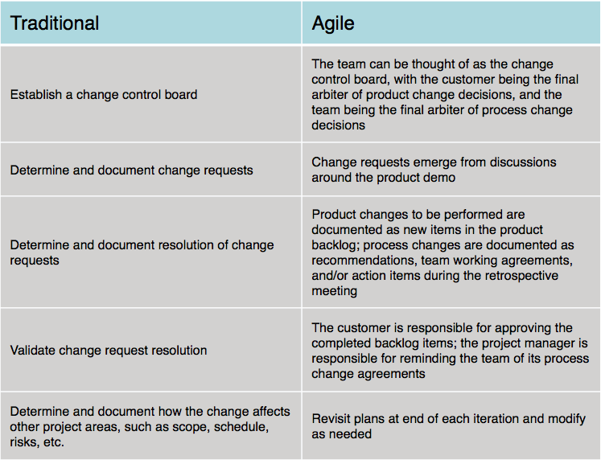
Summary comparison

Slide 15
Change During Development
Sometimes change occurs during development that necessitates changes in scope
Approval of CCB (Change Control Board) and
Requires extensive planning
May require more time/resources (project triangle)
Plan-driven methodologies may or may not have this built in (i.e. Spiral) or may be specifically built to resist change (i.e. Waterfall)
Agile Methodologies embrace change
Scrum allows for change to the Product Backlog at any time, but manages risk by freezing the current Sprint Backlog
Stakeholder Communication IS KEY

Slide 16
Software Change Strategies
Software maintenance
Changes are made in response to changed requirements but the fundamental software structure is stable
Architectural transformation
The architecture of the system is modified generally from a centralized architecture to a distributed architecture
Software re-engineering
No new functionality is added to the system but it is restructured and reorganized to facilitate future changes
These strategies may be applied separately or together

Slide 17
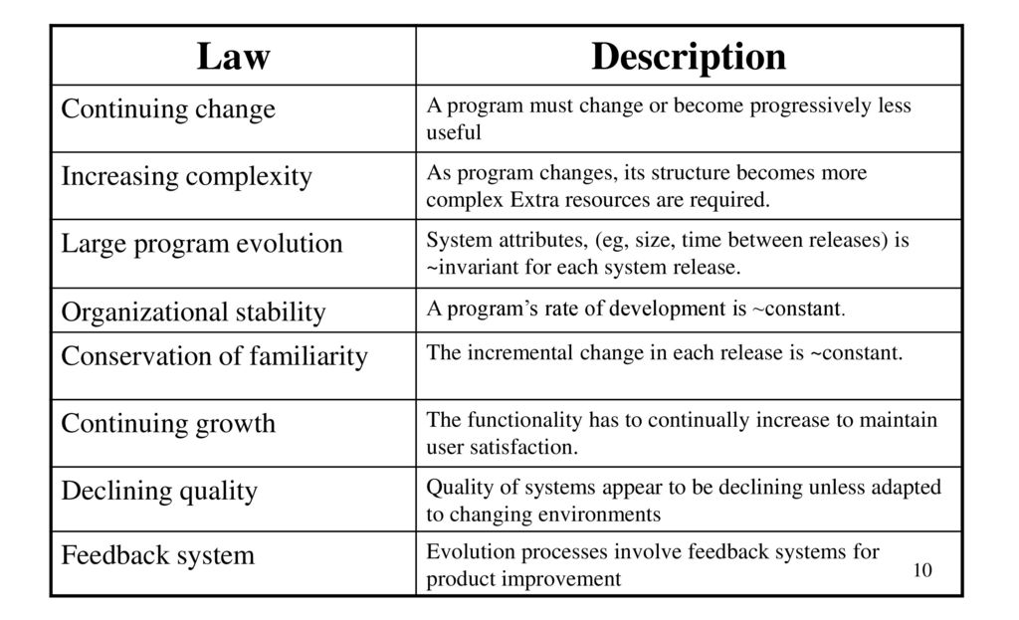
Lehman’s Laws

Slide 18
Applicability of Lehman’s Laws
This has not yet been established
They are generally applicable to large, tailored systems developed by large organizations
It is not clear how they should be modified for
Shrink-wrapped software products
Systems that incorporate a significant number of COTS components
Small organizations
Medium sized systems

Slide 19
Software Maintenance

Slide 20
Software Maintenance
Modifying a program after it has been put into use
Maintenance does not normally involve major changes to the system’s architecture
Changes are implemented by modifying existing components and adding new components to the system

Slide 21
Maintenance is Inventible
The system requirements are likely to change while the system is being developed because the environment is changing. Therefore a delivered system won't meet its requirements!
Systems are tightly coupled with their environment. When a system is installed in an environment it changes that environment and therefore changes the system requirements.
Systems MUST be maintained therefore if they are to remain useful in an environment

Slide 22
Types of Maintenance
Maintenance to repair software faults
Changing a system to correct deficiencies in the way meets its requirements (Corrective Maintenance)
Maintenance to adapt software to a different operating environment
Changing a system so that it operates in a different environment (computer, OS, etc.) from its initial implementation (Adaptive Maintenance)
Maintenance to add to or modify the system’s functionality
Modifying the system to satisfy new requirements (Perfective Maintenance)

Slide 23
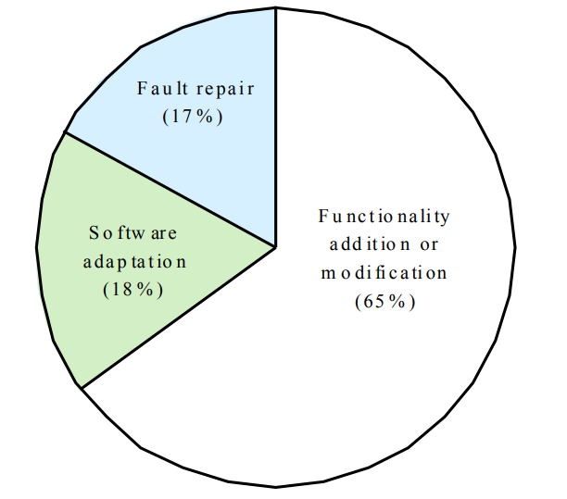
Distribution of Maintenance Efforts

Slide 24
Maintenance Cost
Usually greater than development costs (2* to 100* depending on the application)
Affected by both technical and non-technical factors
Increases as software is maintained. Maintenance corrupts the software structure so makes further maintenance more difficult.
Ageing software can have high support costs (e.g. old languages, compilers etc.)

Slide 25
Maintenance Cost Factors
Team stability
Maintenance costs are reduced if the same staff are involved with them for some time
Contractual responsibility
The developers of a system may have no contractual responsibility for maintenance so there is no incentive to design for future change
Staff skills
Maintenance staff are often inexperienced and have limited domain knowledge
Program age and structure
As programs age, their structure is degraded and they become harder to understand and change

Slide 26
Evolutionary Software
Rather than think of separate development and maintenance phases, evolutionary software is software that is designed so that it can continuously evolve throughout its lifetime
YES, but how/much?

Slide 27
Maintenance Prediction
Maintenance prediction is concerned with assessing which parts of the system may cause problems and have high maintenance costs
Change acceptance depends on the maintainability of the components affected by the change
Implementing changes degrades the system and reduces its maintainability
Maintenance costs depend on the number of changes and costs of change depend on maintainability

Slide 28
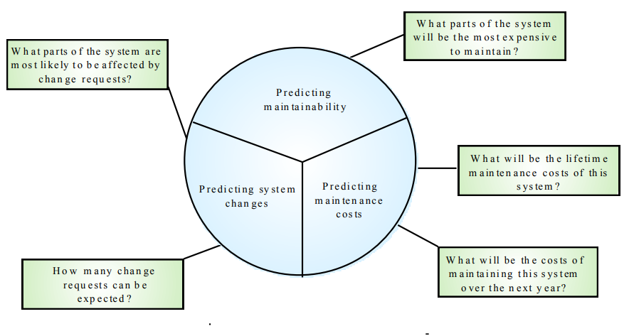
Maintenance Prediction

Slide 29
Change Prediction
Predicting the number of changes requires an understanding of the relationships between a system and its environment
Tightly coupled systems require changes whenever the environment is changed
Factors influencing this relationship are
Number and complexity of system interfaces
Number of inherently volatile system requirements
The business processes where the system is used

Slide 30
Complexity Metrics
Predictions of maintainability can be made by assessing the complexity of system components
Studies have shown that most maintenance effort is spent on a relatively small number of system components
Complexity depends on
Complexity of control structures
Complexity of data structures
Procedure and module size

Slide 31
Process Metrics
Process measurements may be used to assess maintainability
Number of requests for corrective maintenance
Average time required for impact analysis
Average time taken to implement a change request
Number of outstanding change requests
If any or all of these is increasing, this may indicate a decline in maintainability

Slide 32
Architecture Evolution
There is a need to convert many legacy systems from a centralised architecture to a client-server architecture
Change drivers
Hardware costs. Servers are cheaper than mainframes
User interface expectations. Users expect graphical user interfaces (CLI->GUI)
Distributed access to systems. Users wish to access the system from different, geographically separated, computers

Slide 33
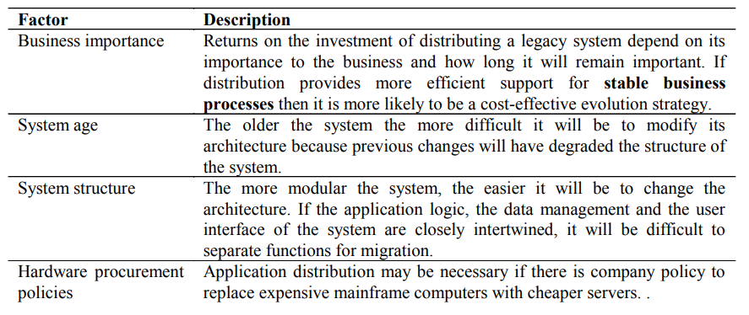
Distribution Factors

Slide 34
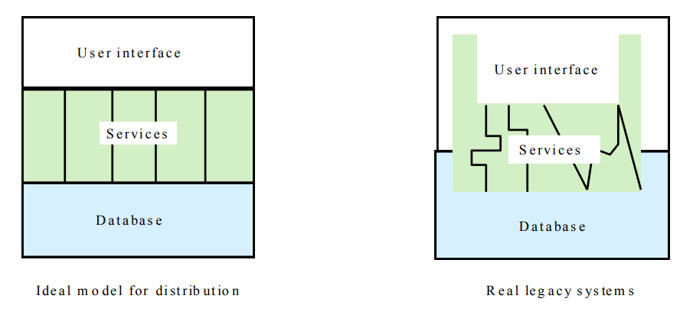
Legacy System Structure
Ideally, for distribution, there should be a clear separation between the user interface, the system services and the system data management
In practice, these are usually intermingled in older legacy systems

Slide 35
Key Points
The costs of software change usually exceed the costs of software development
Factors influencing maintenance costs include staff stability, the nature of the development contract, skill shortages and degraded system structure
Architectural evolution is concerned with evolving centralized to distributed architectures
A distributed user interface can be supported using screen management middleware

